Slide 1
The effects of wealth, sex and birth year on life expectancy
Rufus Turner

Slide 2
Hypotheses
Null Hypotheses are
The wealth of a country will have no effect on Life Expectancy
There will be a no differences between sexes for Life Expectancy
There will be no effect on birth date for Life Expectancy

Slide 3
Methods used
Data was taken from Kaggle –World Development Indicators
Countries were divided into 1) high and 2) medium and low income groups
Life expectancy (both total and by sex) variable was extracted and observed to investigate if there were differences based on wealth, sex or year
This was exploratory data analysis so no statistics were performed
Juptyer Notebooks alongside Matplotlib and Seaborn for graphical display

Slide 4
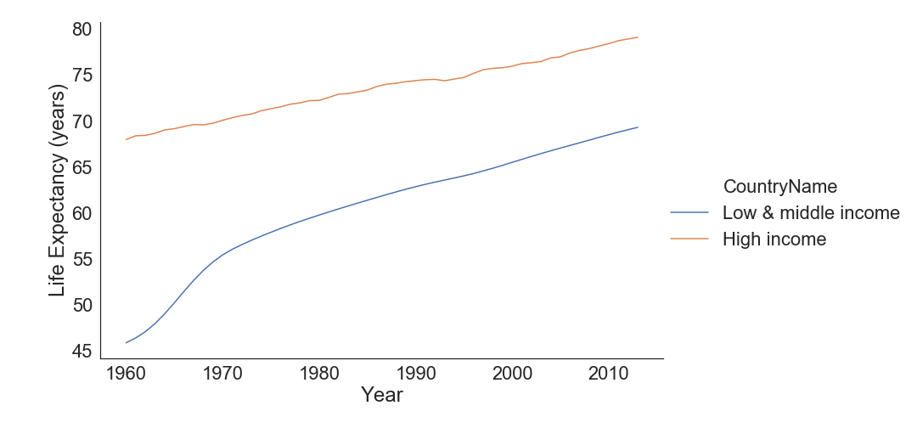
Life expectancy of a child based upon year of birth and wealth of country
Life expectancy is longer for wealthier countries
Larger increase in life expectancy in 1960’s for low and middle income countries
Life expectancy increases as the closer to present day a child is born

Slide 5
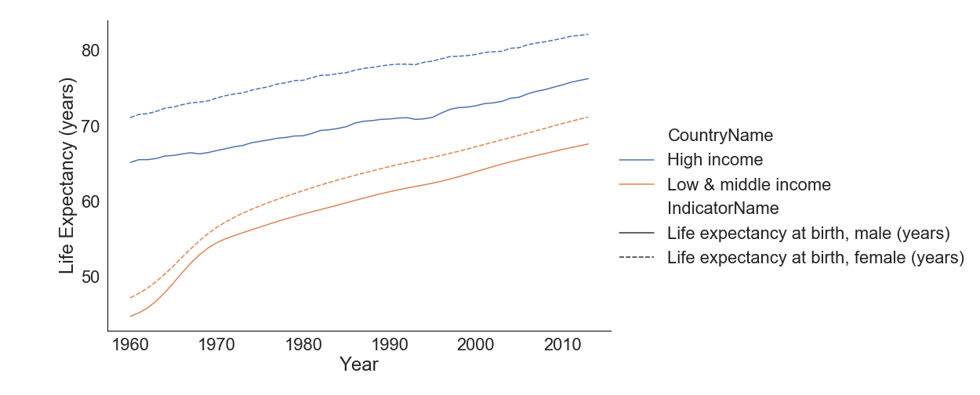
Life expectancy of a child (male and female) based upon year of birth and wealth of country
Life expectancy for Females is longer than for Males on average
Life expectancy difference between females and males is larger for high income countries cf low & middle income countries

Slide 6
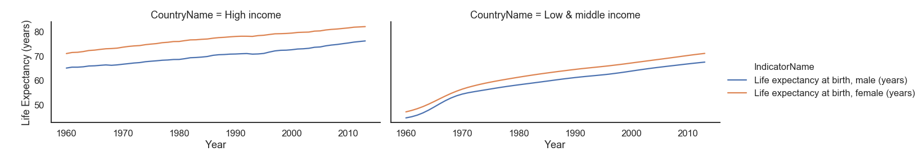
Alternative way to display Life expectancy of a child (male and female) based upon year of birth and wealth of country

Slide 7
Conclusions
Life expectancy increasing the closer you get to 2013 for both males and females
High income countries have higher life expectancy than low and middle income countries for both sexes
After an initial large increase in low and middle income countries in 1960’s, the rate of increase in life expectancy is similar between high income and non-high income countries

